Slide 1
Leave management system Seminar
Year 2, Group 3
Michal, Wei, Ben ,Owen , Hao

Slide 2





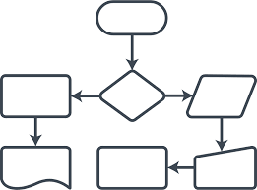

Tasks Completed So far
Communication - Discord
GITHUB
TRELLO
PYTHON REASEARCH
SQLite Research
Flow Chart
LESEPI
Quality assurance document
Michal

Slide 3

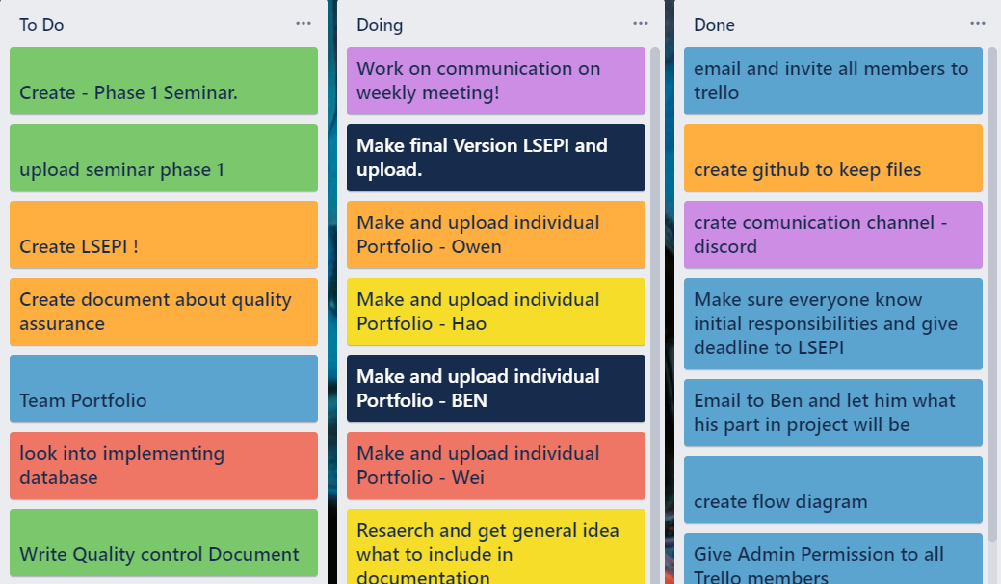
Trello Board
Planning
Tracking
Updating
Michal

Slide 4
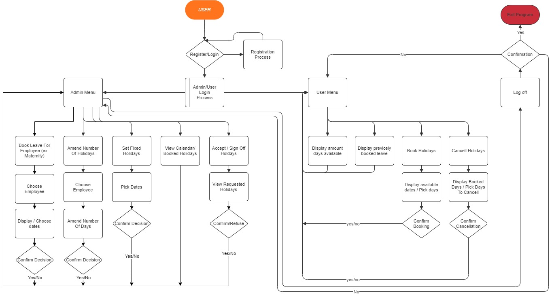
FLOW Chart
Application will let you login either as admin or user
Different options access depending on login credentials
Connection with data base established when program starts
Data base connection maintain during running app
Michal

Slide 5


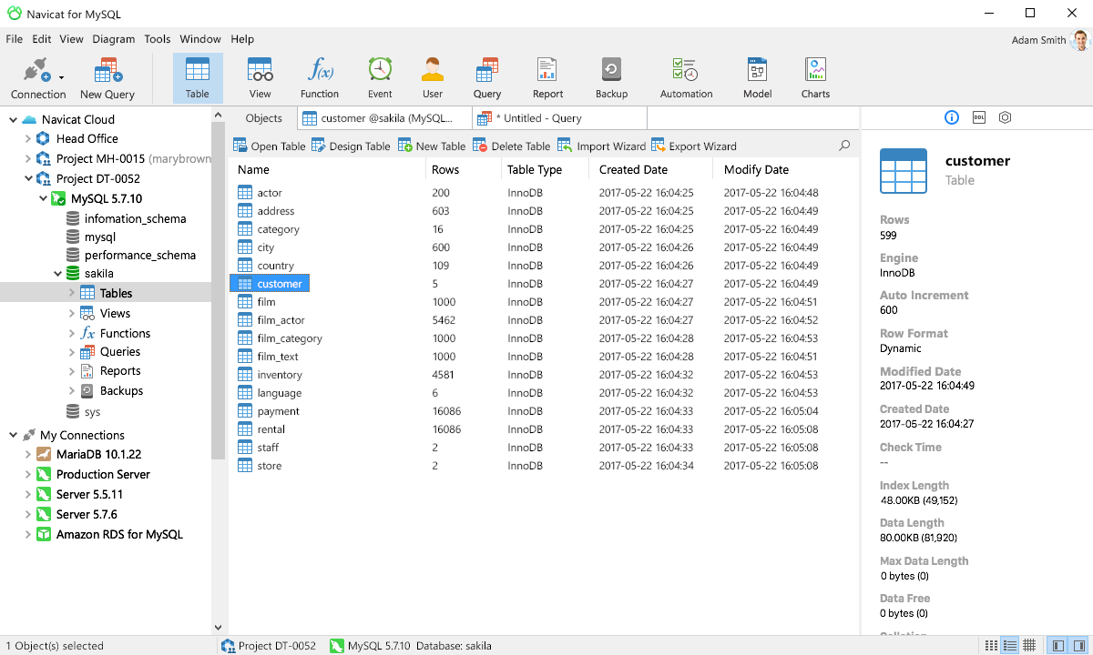
Great tool for database design
Navicat is a great database management tool. Based on GUI. Good for somebody who not like the shells. It also can use it to build the ER diagram.
Wei

Slide 6
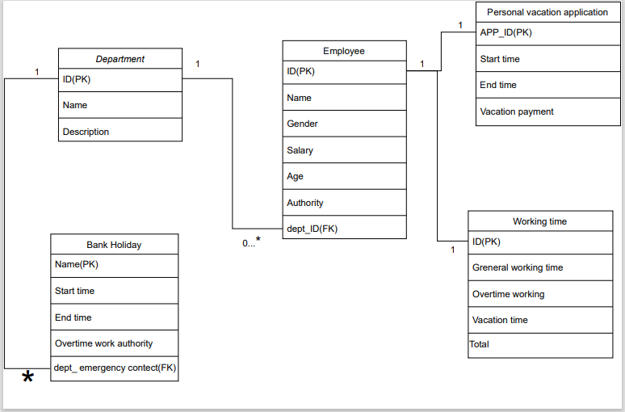
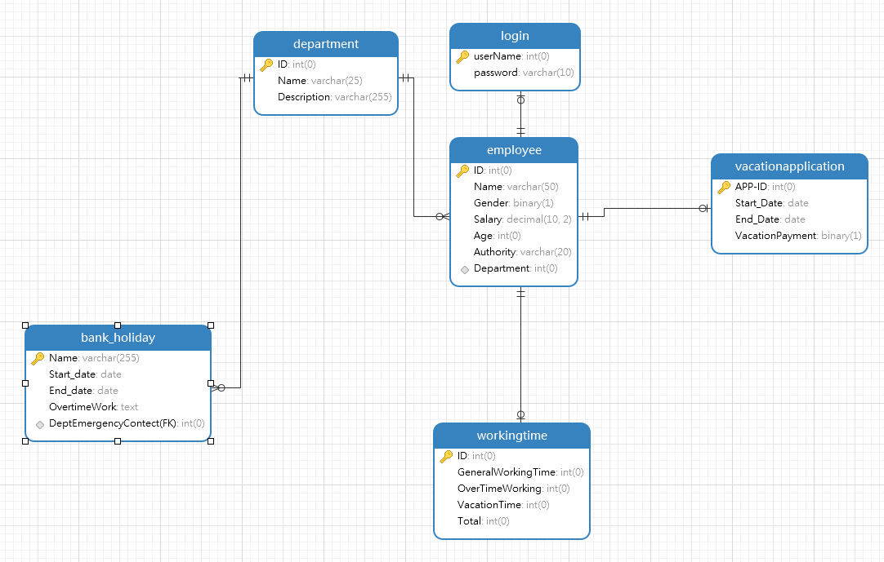
ER diagram design
We drawed the first edition of ER diagram
We used the Database visualization tools to generate this Er diagram
Wei

Slide 7
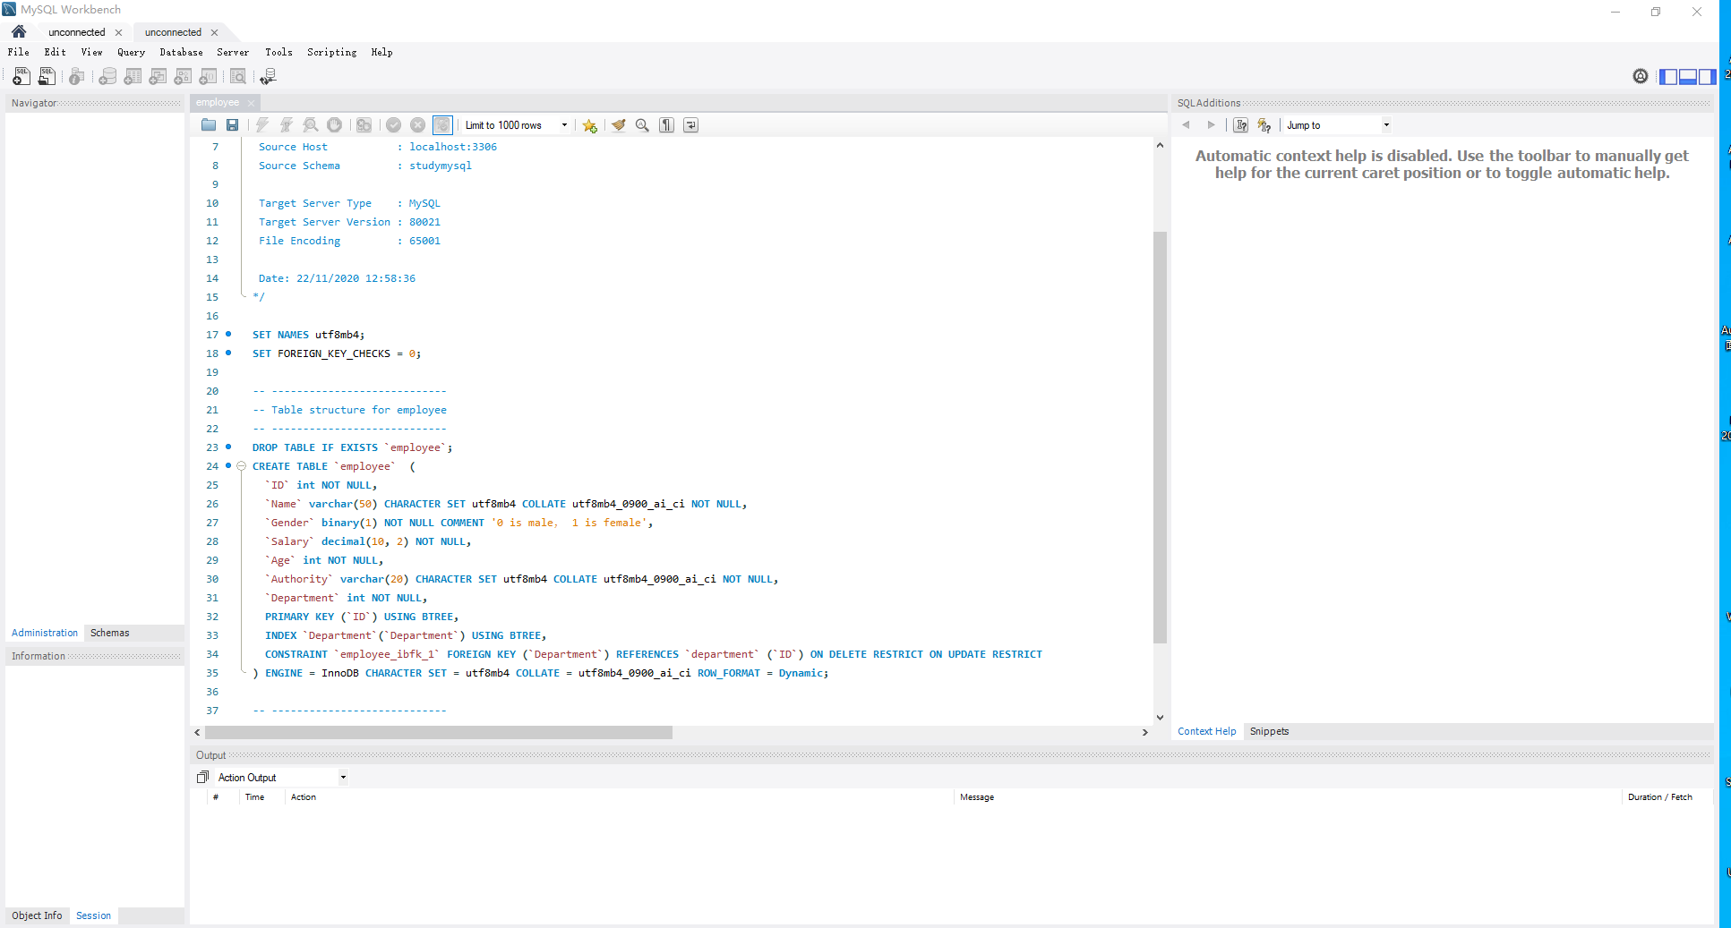
SQL create code
(MySQL edition)
Wei

Slide 8
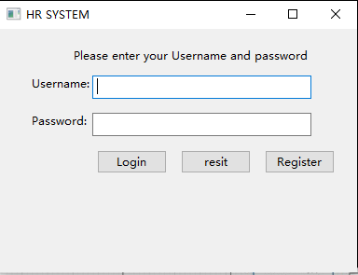
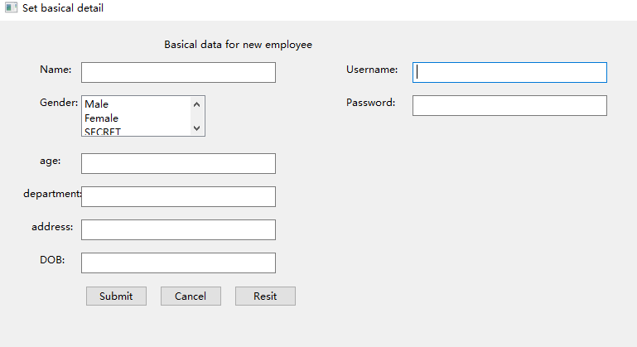
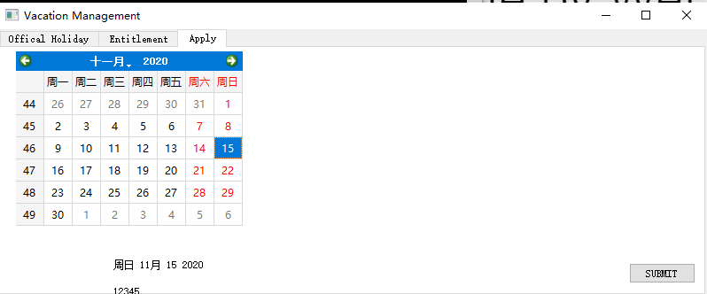
GUI FIRST EDITION
USER COMMUNICATION INTERFACE
LOGIN
REGISTER
Wei

Slide 9
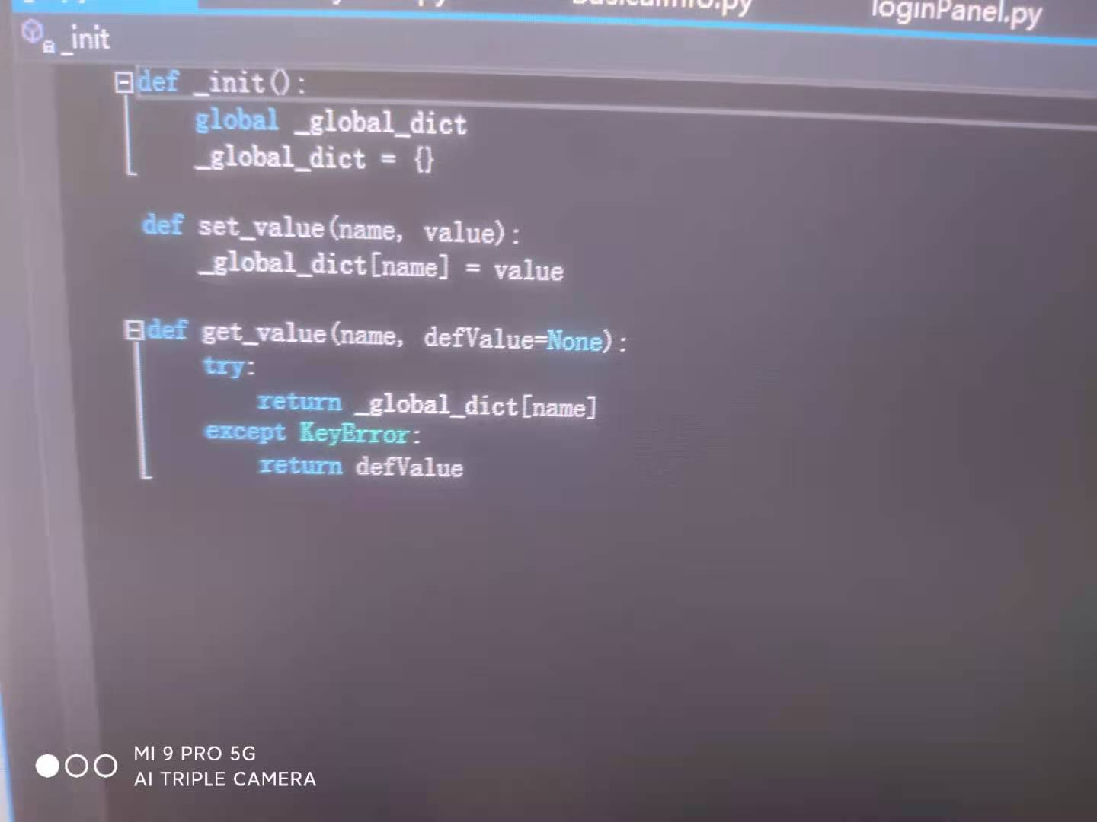
Problem:Transform global variable between each ".py" documents.
This is a global data management program. Is an individual ".py" document.
Wei

Slide 10
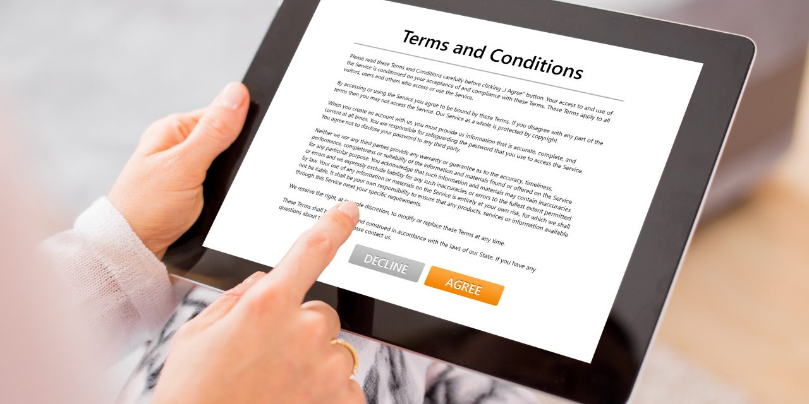
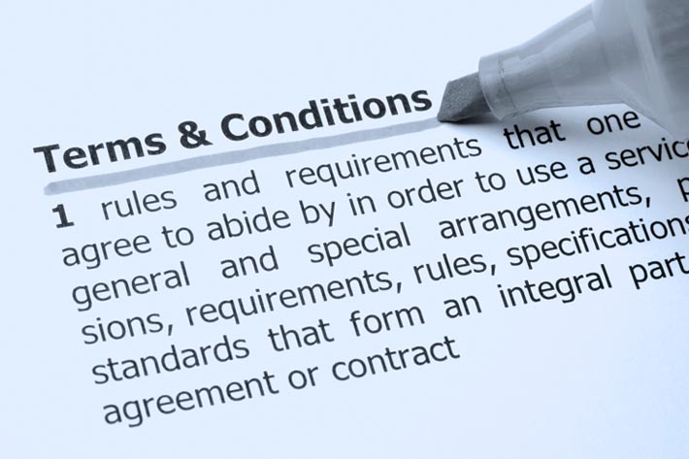

LSEPI
Why is LSEPI?
Legal, Social, Ethical, Professional Issues
Why is LSEPI Important?
Legal side of software documents
Covers your company
States out terms and conditions
Allows users to understand any issues/terms
What kind of things should LSEPI include?
Terms and conditions
Issues with the software from LSEP perspective
Ben

Slide 11
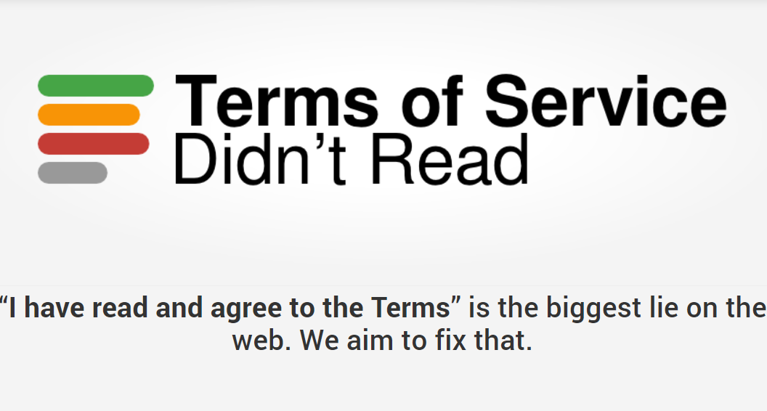
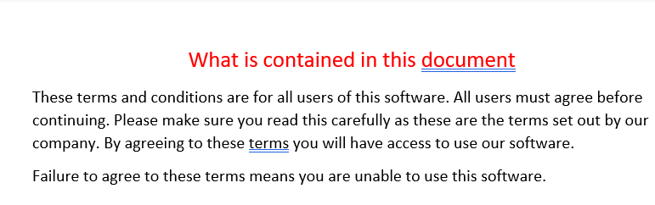
What is important for LSEPI
-Making sure that the document is clear
-Making sure the user understands the document
-Ensuring the document is layed out correctly in a good format.
-Clear wording, Not misleading or complicated.
Ben

Slide 12

How LSEPI work
Using personal information from the users
Storing data correctly
Stating what information will be used and collected
Ensuring users know what and how we are using their data safely.
Stating that data will not be used for longer than necessary
Ben

Slide 13
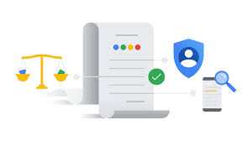
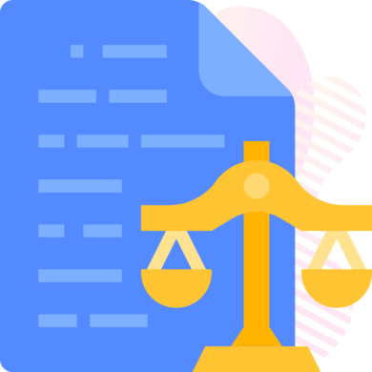
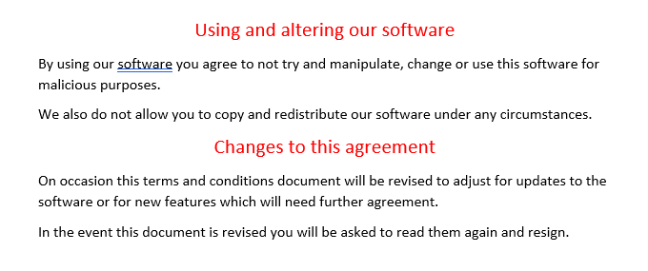
LSEPI might change
Covering your software from a legal stand point to ensure your company does not receive back lash / off of earnings.
Letting the user know there may be changes to the document and to ensure that they read it every time it appears as it may have changed.
Ensuring your software does not get redistributed without your permission.
Ben

Slide 14
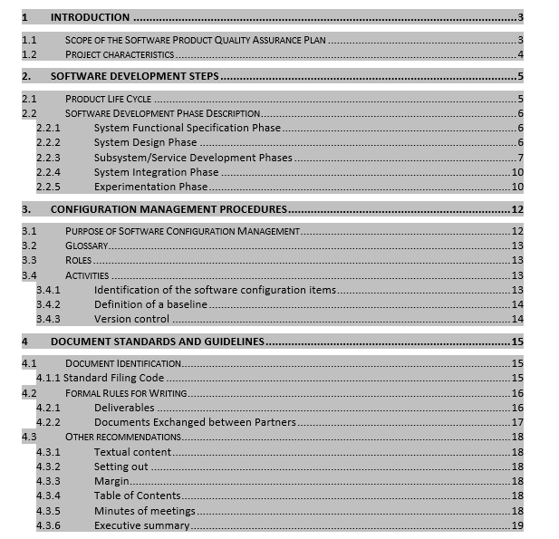
Quality assurance document
This document is to ensure that the program works as specified in the design brief, it is an extensive document with checks that must be carried out for insurance that it will be perfect for the company. This includes checks these checks include:
System function specification
Design
Accessibility
Security
Compatibility
Owen

Slide 15

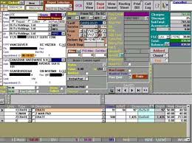

System function check
Design check
This is to ensure that the all the components of the program work as specified in the design brief and that they all work together as intended by the programmer. This also includes how much of the computers resources the program uses and to make sure that it is as affiant as posable.
This will ensure that the program looks as specified in the design brief and ensure that it complies with the other checks for example accessibility so that it can be seen clearly and easily, this is to ensure that it can be understood by people with no small text or hard to see colours.
Owen

Slide 16


Accessibility check
This is to make sure that the program is accessible to all employees that includes people that have posable difficulty's working with computers or people with disabilities.
Security check
The program must be made so that there are no exploits in the code so that people will not be able to access other peoples details or allow bad acters to have access to the system.
Owen

Slide 17
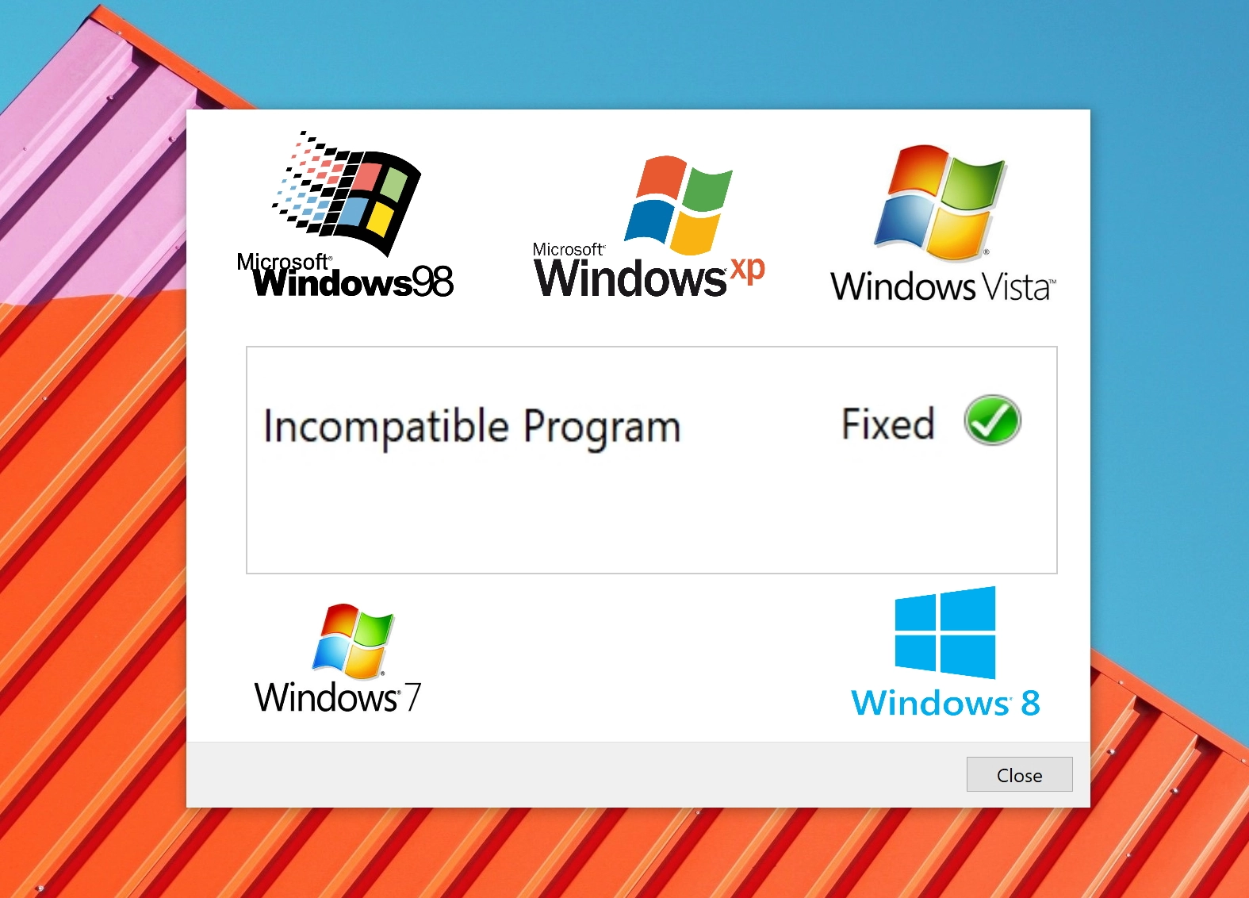
Compatibility check
This check is to ensure that the program is compatible with a wide range of systems that the company uses so that all employees can use it throughout the company and that the program runs smoothly on all workplace systems with no crashing or bugs that can affect the program from starting or messing up part way threw.
Owen

Slide 18
Thank you

